Slide 2
DevOps Playground
Inspiring tech-enthusiasts to explore new technology during hands-on monthly events.

Slide 3

Hands on with Ansible
Yuliya Nedyalkova
Notes:
Welcome to our playground. Today’s edition is dedicated to Ansible.
My name is Yuliya, I am a DevOps Consultant at ECS Digital.
Look around……

Slide 4

Welcome to the Playground
Yuliya Nedyalkova
Notes:
See all those people wearing a Panda Made me do it T-Shirts?
They will be helping us out during the playground.
So should you have any difficulty, just raise a hand.
Due to time constraints we probably won’t be able to answer all questions during the presentation and the workshop.
But worry not, you can ask us as many questions as can come to your mind while enjoying some pizza and drinks after the workshop.
LEADER: Before we begin, check that you have picked up the information-slip from the reception. If you haven't you can do so now. You have one minute

Slide 5
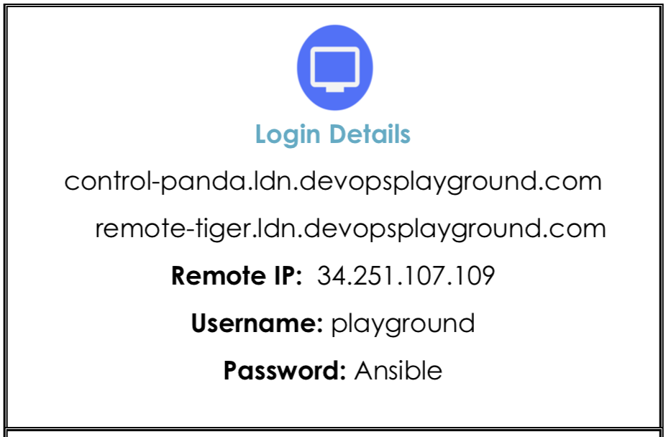

Notes:
Let’s start.
LEADER: During our Playground our task will be to answer several questions

Slide 6
What is Ansible?
What is Ansible used for?
Why use it?
How we use it?
Hands-on workshop on Ansible
Notes:
Read through the questions......
Who has heard about Ansible? Written and run a playbook?
LEADER: So what is Ansible?

Slide 7
What is Ansible?
Notes:
LEADER: It is an open-source TOOL that does several things:

Slide 8
Ansible does…
Provisioning | Configuration management | Application deployment
Continuous Delivery | Orchestrations | Security compliance
Notes:
Provisioning
Provisioning provides equipment, software or services to users. Just to name some
Storage Area Network (SAN) provisioning: Optimizes performance by efficiently appropriating storage to all users.
Server provisioning. Setting up a server for use in the network. It may refer to installing the operating system and other system software,.
User provisioning: Involves creating, maintaining and deactivating of users.
Configuration management
Think of those times when you had to configure manually the software you’ve just installed. Ansible centralises configuration file management and deployment.
Application deployment
We can deploy multi-tier applications reliably and consistently. Instead of writing custom code to automate our systems, we write simple task descriptions and run them from one centralised location.
Ansible is broadly used in:
Continuous Delivery
One common way to use Ansible is to make your CI server call it once your applications was successfully built:
The CI asks Ansible to run a playbook that deploys a staging environment with the application.
When the stage tests pass, it might then be asked to run a production deployment.
Orchestration of services
What if we are dealing with a complex IT orchestration. What if our platform is built on a variety of separate services - such as services for storage, networking, identity? Each of these services has their own dependencies on other services and other components, and each has their own separate configurations, and sequences for deployment and upgrading. Attempting to deploy, operate and upgrade so many services can become complex and error prone. And here is when Ansible comes in very handy.
Security compliance
Once you have defined your security policy in Ansible, it can be integrated into other automated processes. Ansible’s idempotent nature means you can repeatedly apply the same configuration, and it will only make the necessary changes to put the system back into compliance.
Idempotency is the idea that an operation will produce the same result after the first application, no matter how often it is repeated.
LEADER: Now that we know what Ansible does, let’s take a moment to think why choose Ansible?

Slide 9
Why use Ansible?
Notes:
LEADER: Anyone would like to share thoughts?

Slide 10
Why use Ansible?
Powerful
Easy to use
Non-disruptive
Secure
Cross-platform
Notes:
POWERFUL:
Rich with built-in reusable features.
Caters for state management – you describe the desired state of your systems and Ansible figures out how to achieve it.
By design we have a greater chance of repeatability, consistency and atomicity.
The power also comes from succinct commands, yet with rich consequences.
EASY TO USE:
Human Readable
Easy to install and do the initial setup.
No programming expertise
NON-DISRUPTIVE
You don't have to deploy custom agents because Ansible delivers all the packages to the remote host.
Once the packages are executed they clean after themselves.
SECURE
Ansible relies on the most secure remote connection available as its default transport layer: OpenSSH.
But it doesn't use SSH only. In other hosts (different OSs ) we will use different types of connections. Example: Windows will be using WinRM.
CROSS-PLATFORM
UNIX, LINUX, WINDOWS
Physical, Virtual, Cloud, Container
Network Devices
LEADER: Well, how do we use it?

Slide 11
How do we use Ansible?

Slide 12
CLI or GUI
Ansible Tower
AWX
Notes:
Meet the two faces of Ansible. You can use it from the command line or from the GUI
What you see here is Ansible Tower - A web interface you can use when working with Ansible. It comes with the perks of exposing a RESTful API.
LEADER: How is it all organized?

Slide 13
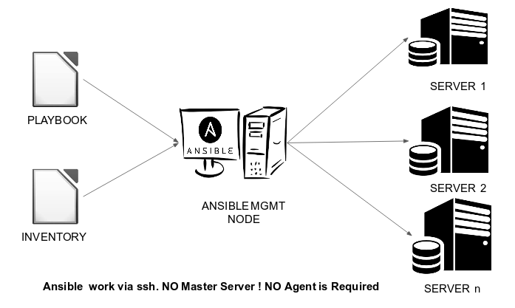
Ansible architecture
SCM
ANSIBLE CONTROL
NODE
Notes:
When working with Ansible, you will work from an Ansible control node and operate on remote hosts.
The Ansible control node is the machine which is responsible for running a playbook and sending the desired configuration over to the remote hosts. The Ansible Control node can be any machine, even your laptop. A user writes IT tasks in a playbook and mentions the IP Addresses in the inventory of hosts. Just by running one ansible command, the user will be able to install and configure packages, create and give permissions to users, create and hydrate databases, all sort of other IT tasks, on each remote host.
LEADER: What are the main components of Ansible?

Slide 14
Concepts and Terminology
inventory
of hosts
playbooks
reference
break down into
contain
roles
tasks
use
use
modules
templates
Notes:
Go through components
LEADER: Lets start with MODULES

Slide 15
How do we use Ansible?
Modules
Notes:
Modules are the smallest building blocks in Ansible. They are built-in units of code that execute IT tasks to control system resources, like services, packages, or files or handle execution of system commands. Each of them is created for specific purpose, each one is reusable.
The modules can be used from the command line or in a playbook task.
LEADER: Let’s take a look at an example of module

Slide 16
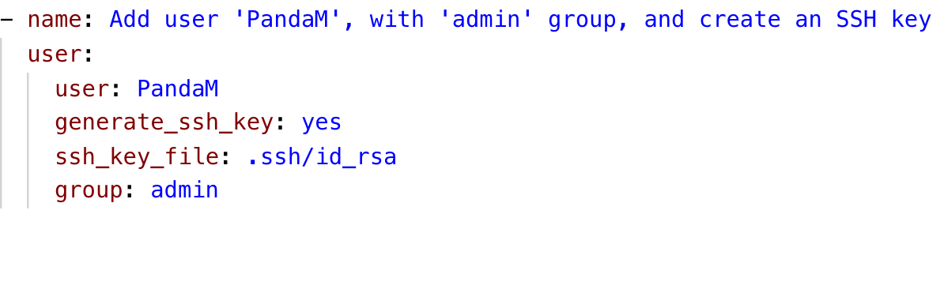
Example of a “user” module
Modules
Notes:
This is an example of user module.
What do you think it does?
Talk through the components of the file
LEADER: There are 1300 modules that ship together with Ansible. Let’s have a look.

Slide 17
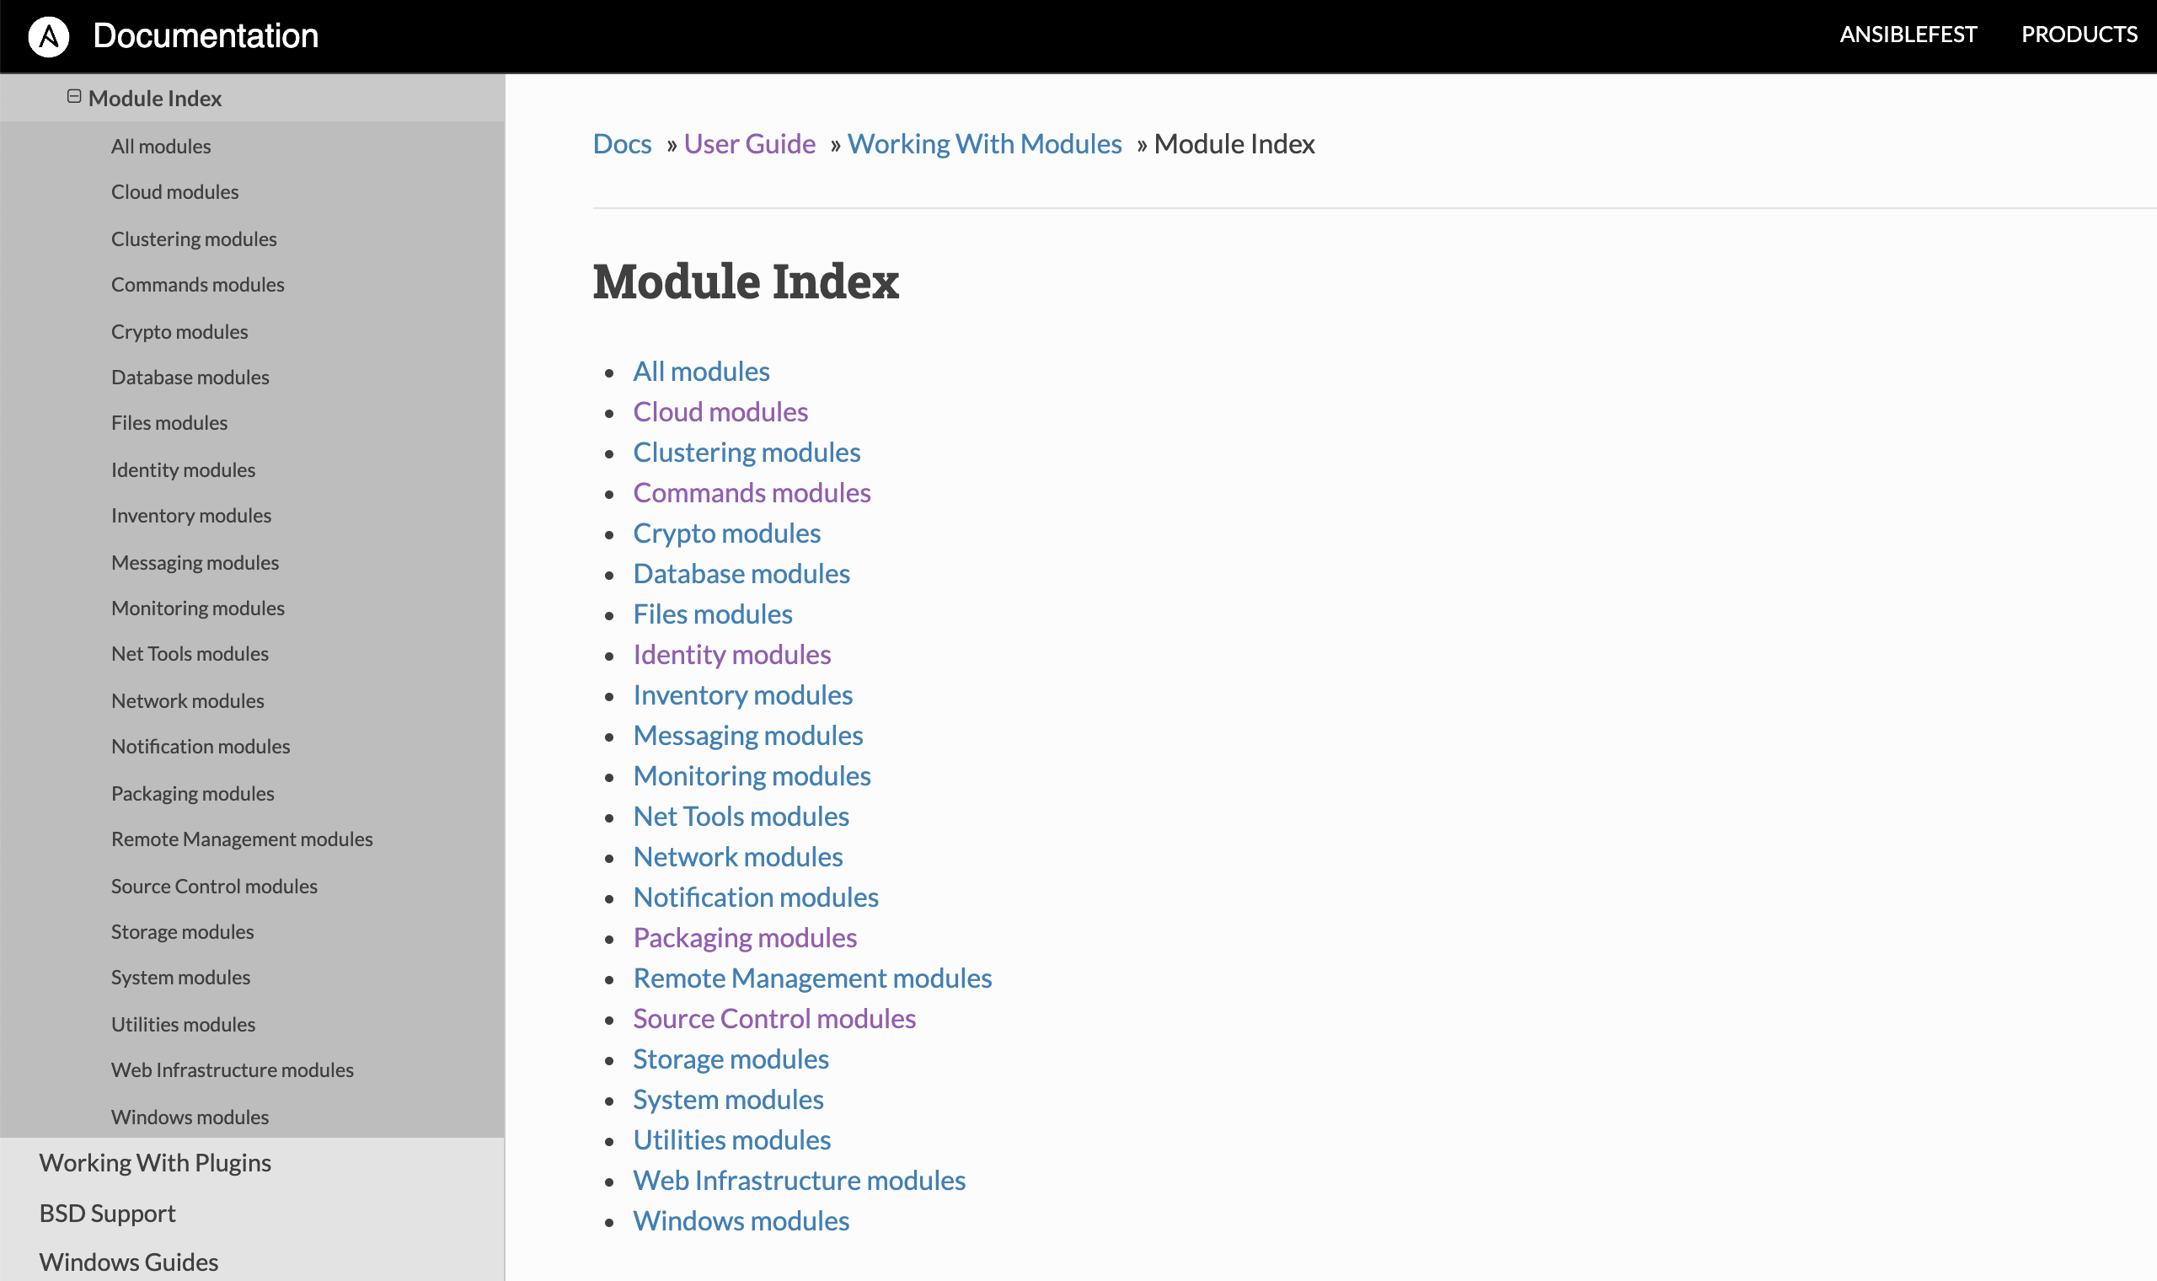
https://docs.ansible.com/ansible/latest/modules/modules_by_category.html
Modules
Notes:
Categories
LEADER: Let’s take a look inside one of the categories.

Slide 18
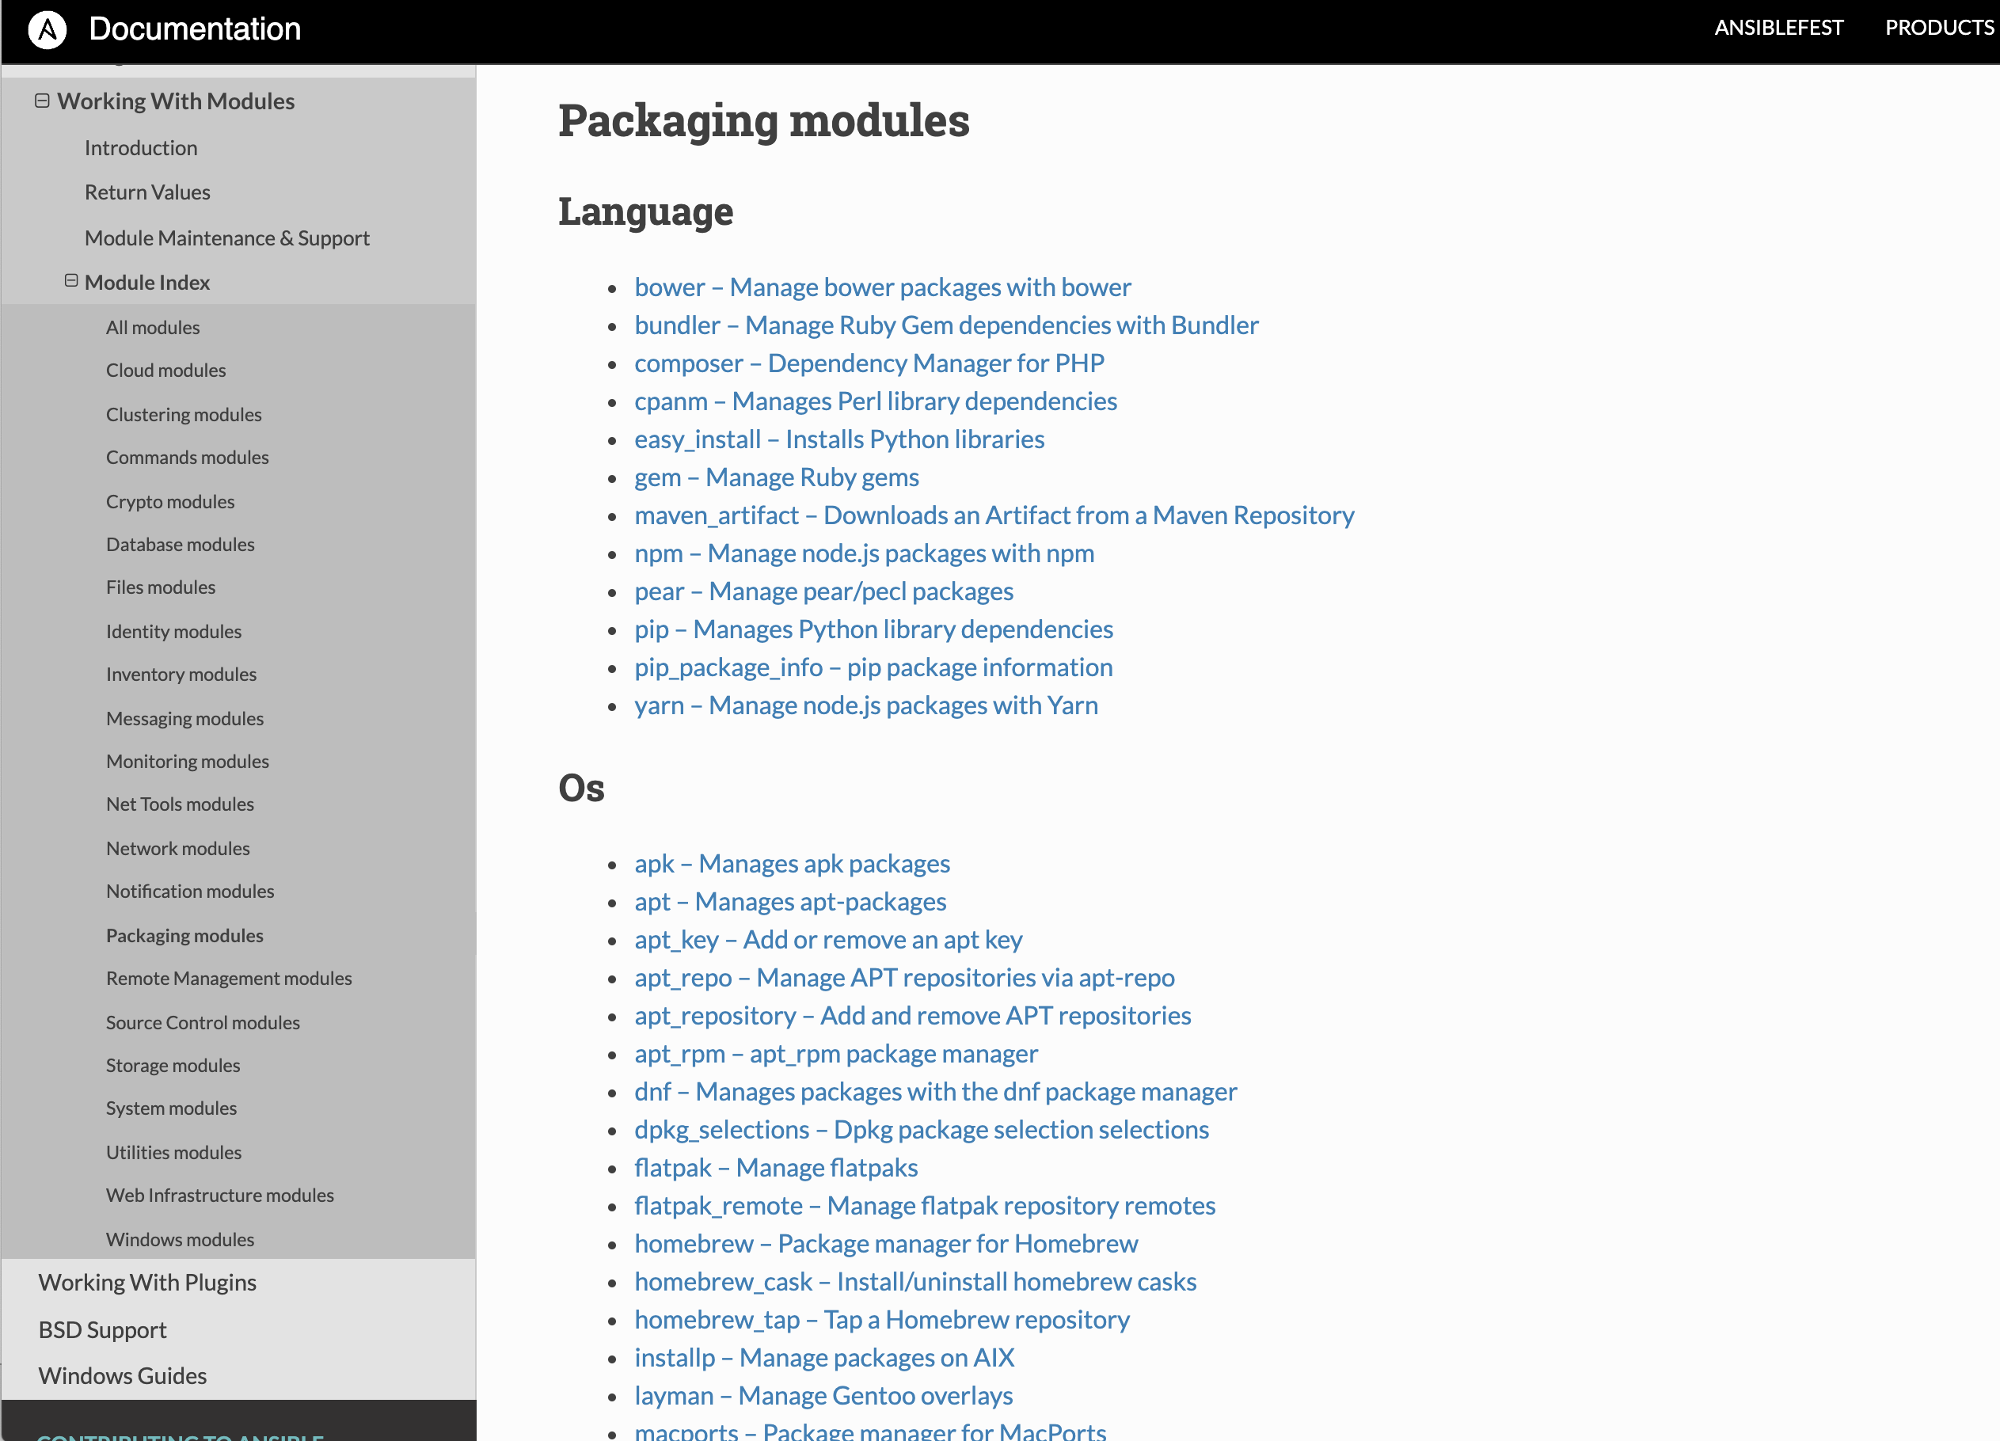
Modules
Notes:
Example of packaging modules.
LEADER: We previously said that the modules can be run from inside tasks.

Slide 19
How do we use Ansible?
Tasks
Notes:
Tasks is the file where a user defines the steps that he needs to perform on the Playbook.
LEADER: An example of a task file

Slide 20
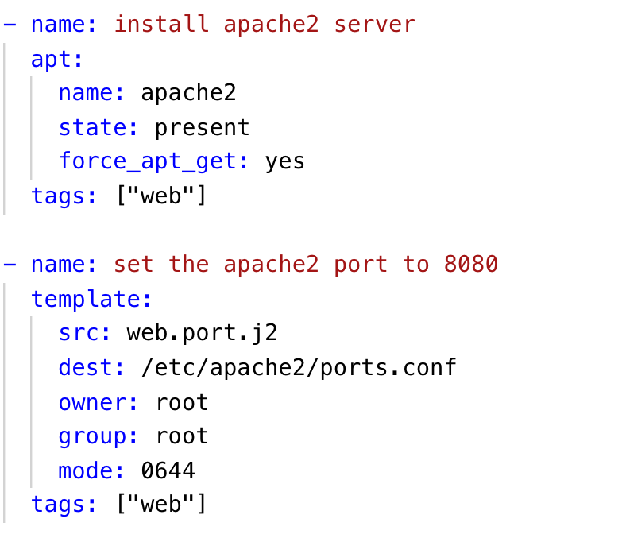
Tasking Ansible
Tasks
Notes:
Here is an example of a task file.
Again, it is written in YAML.
For those who don’t know, YAML stands for “YAML Ain't Markup Language” and it is a human-readable data-serialization language.
Talk through the key terms and what they do.
tags: is useful for debugging…
LEADER: We can describe more than just one task in out tasks file

Slide 21
Tasking Ansible
Tasks
…
Notes:
Here the second task is……..
Ansible runs each task in parallel across all hosts.
Ansible waits until all hosts have completed a task before moving to the next task.
Ansible runs the tasks in the order that you specify them.
LEADER: But where do we get the template from?

Slide 22
How do we use Ansible?
Templates
Notes:
The templates play active role when we carry out configuration tasks.
A template is a file which contains all your configuration parameters, but the dynamic values are given as variables.
Ansible leverages the Jinja2 templating language. Jinja2 is broadly used across the Python ecosystem. It is modelled after the Django templates.
Most commonly the Templates are used for generating configuration files.
LEADER: What does a template look like?

Slide 23
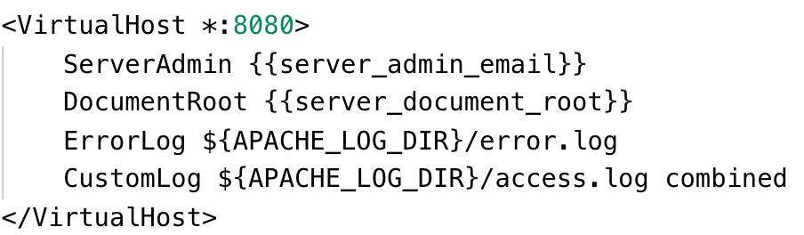
Templates
Templates
Notes:
This is a simple example of a template that will configure Apache Virtual Host.
The parts in curly braces will be replaced by their values when we execute the Playbook.
Ansible will place this configuration file on the remote host in the location that we choose.
LEADER: So now that we have all our building blocks, how do we tell Ansible which hosts we want to configure?

Slide 24
How do we use Ansible?
Inventory
Notes:
Ansible can manage only the servers it explicitly knows about.
LEADER: For this purpose we create an INVENTORY file where we specify information about those servers.

Slide 25
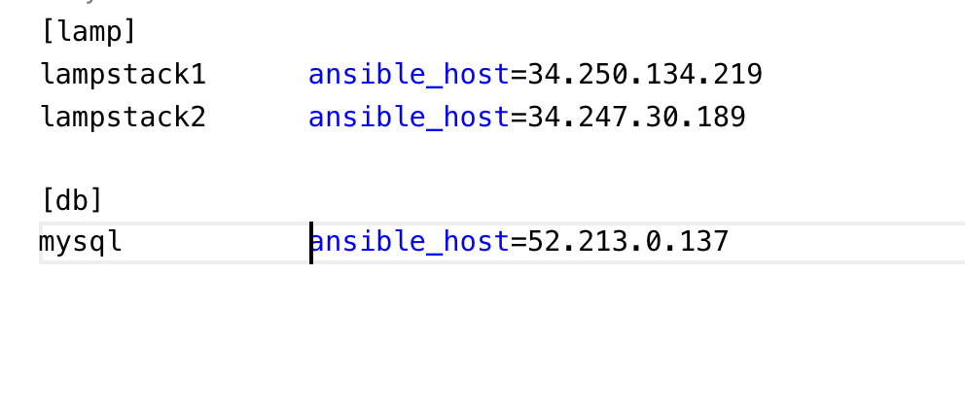
Inventory
# default location
/etc/ansible/hosts
Notes:
Here is an example of an Inventory file.
ACTION- [Talk through the file components] ->> IP addr, key_word, name/alias , groups, nesting
Default location is /etc/ansible/hosts. But we can create a inventory file at the root of our project.
Well this is all good, Ansible is rich with features. But what is we had to keep let’s say 50 tasks and templates together?
We organize them in Plays to run them automatically in the correct order.
LEADER: Those PLAY are written out in Playbooks.

Slide 26
How do we use Ansible?
Playbook
Notes:
With Ansible you write 'Playbooks' that are descriptions of the desired state of your systems.
If modules are you building tools then playbooks are the instruction manuals for what policy we want to enforce on our remote servers.
I picture this as if I was hitting the button PLAY when I want Ansible to run those instructions.
LEADER: Here is an example of a playbook.

Slide 27
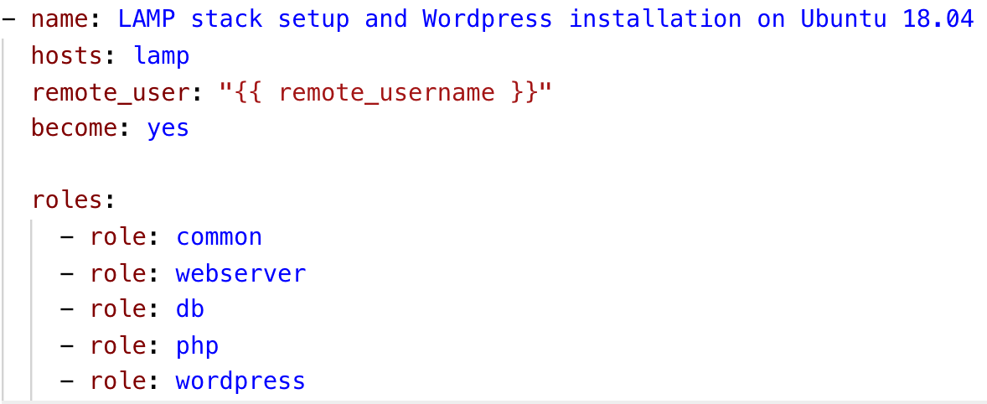
Ansible playbook
Playbook
Notes:
Can you recognise the language?
Talk about what we see in the playbook.
The Playbook centralizes all the components that Ansible needs to run successfully its assignment and put the hosts in the state that we desire.
ONLY IF ASKED: How does the playbook work in detail?
Ansible will do the following:1. Generate a Python script that installs Nginx package. 2. Copy the script via SSH connection to “prod“ servers. Execute the script on the “prod“ servers. Wait for the script to complete execution on all hosts.

Slide 28
# Command to run the ansible playbook:
$ ansible-playbook file.yml
Notes:
This is how we run a playbook from the command line.
LEADER: As you noticed, our playbook looks very tidy and easy to follow. This is thanks to using Ansible Roles.

Slide 29
How do we use Ansible?
Roles
Notes:
When we write a Playbook, it can easily become large, hard to understand and maintain. At the same time we can see sets of tasks, templates and other components to logically gravitate around organisational ideas.
LEADER: We call those ideas - ROLES.

Slide 30
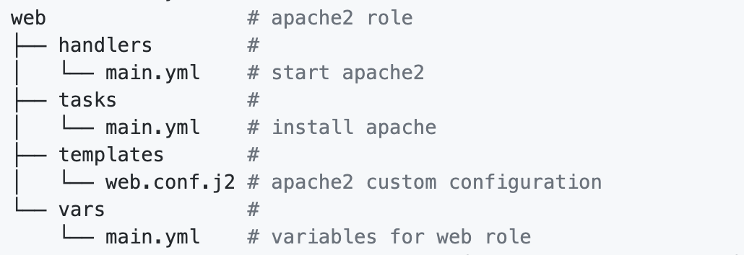
Roles
Role
Notes:
Roles are a convenient way to bundle tasks, supporting assets such as files and templates. By using a concept most programmers would be familiar with, of including files and folders, a playbook becomes infinitely more readable and understandable.
Roles are basically made up of tasks, handlers, and configurations, but by adding an additional layer to how a playbook is structured, we can easily get the big picture overview as well as the low-level details.
This allows for reusable code and a division of work in a team tasked with writing playbooks. For example, the web server guru can write a role (almost like a partial playbook) for setting up the web server and the database team can write a role for configuring a database.
Roles expect files to be in certain directory names.
LEADER: You can write your own roles, but before you do that, I advise you to check out the Ansible-Galaxy roles-hub.

Slide 31
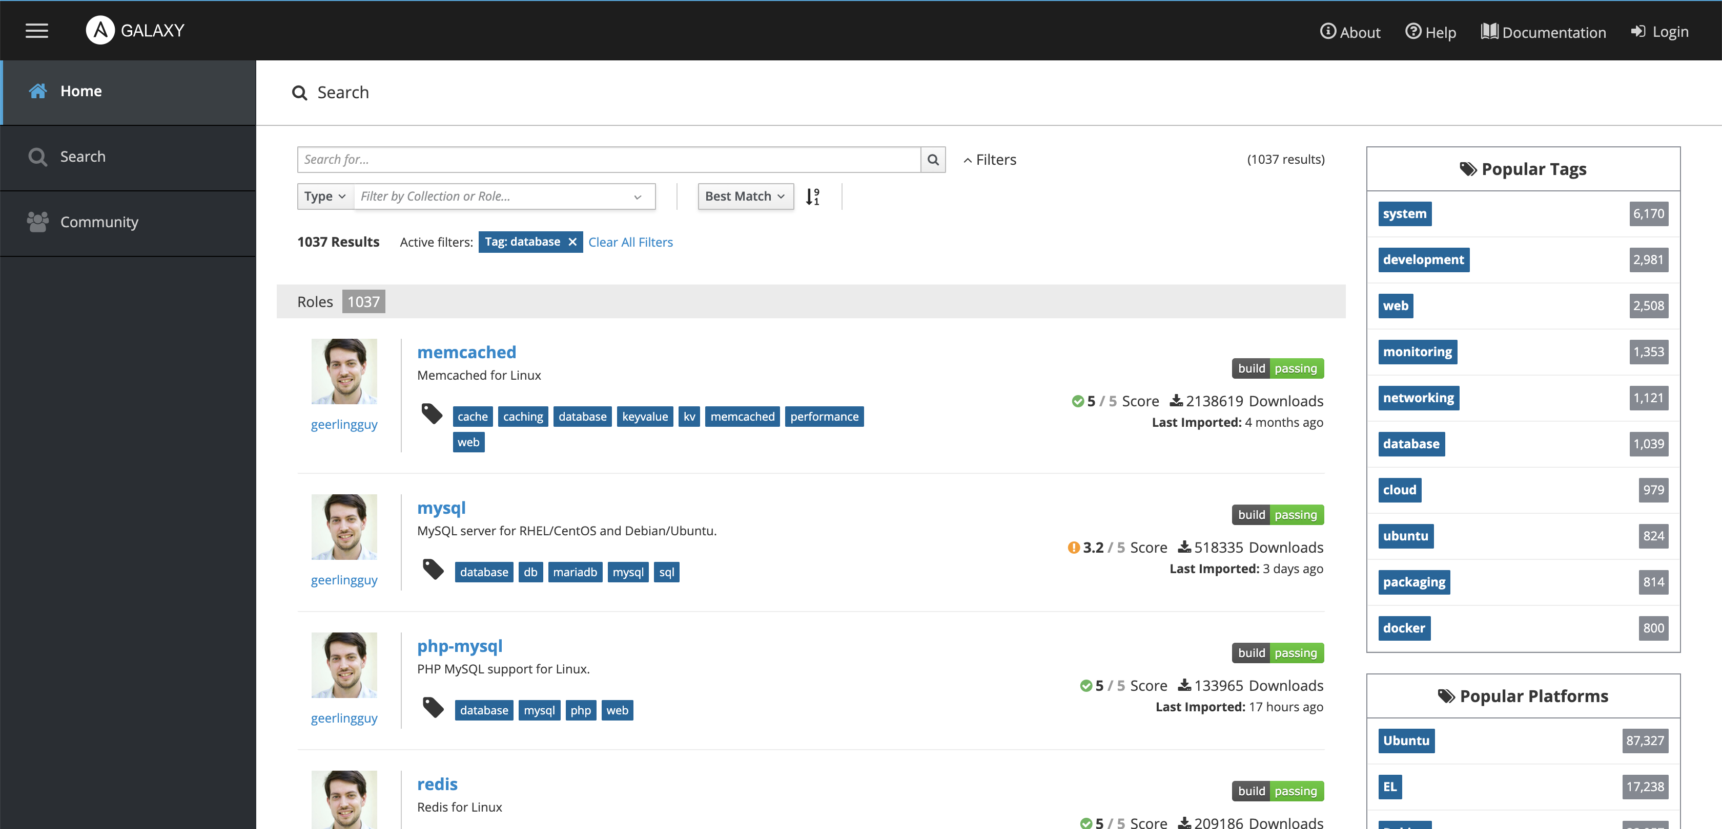
ANSIBLE GALAXY – database roles
Notes:
It is a huge collection of commonly required roles contributed by the Ansible community. You might find there just what you need and they are easy to use.
LEADER: I have come to the end of the presentation.
We covered briefly what Ansible is, we discussed some of its strengths, we spoke about its structure.
I know that this is a lot of information to take in. But Ansible provides rich documentation and tutorials you can consult at any time.

Slide 32

Ansible Workshop
type in your browser
bit.ly/ans-workshop
or
https://github.com/DevOpsPlayground/Hands-on-with-Ansible-Oct-2019

Slide 33
Thank you
Any questions? Stay for a chat!

